Slide 1
Advancing Ethics Frameworks and Scenario Development to Support e-Research in Educational Contexts
Jocelyn Wishart

Slide 2
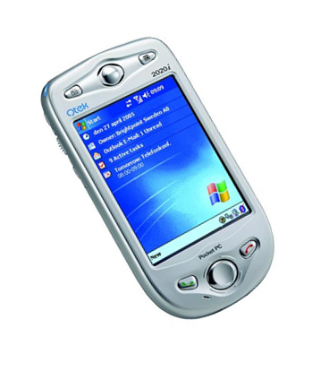
Advancing Ethics Frameworks and Scenario Development to Support e-Research in Educational Contexts
Jocelyn Wishart
Why did I start thinking about ethics?
Study of Handhelds in Teacher Education

Slide 3
I found concerns arising when I or a trainee science teacher used a handheld mobile device in:
Documenting evidence – trainees’ progress against nationally set standards
Using the camera – recording one-off demonstrations
Fieldwork – bridging the classroom and the real world
Reflecting on trainees’ errors – should I have kept this image?
Also found that personal use was important to trainees’ success at using the device to support learning but invasive?

Slide 4

So why are ethical issues in researching mobile learning a concern?
handheld devices provide multiple opportunities for access to personal information including images
their portability creates a lack of boundaries
they link to both real and virtual contexts
their capabilities are often poorly understood
Also the classic approach of adhering to a fixed code of conduct or having your proposed methods first evaluated by an ethics committee does not deal well with the changing contexts arising in mobile learning research.

Slide 5
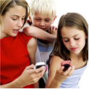
Four accepted ethical principles:
Do good
Avoid harm
Autonomy (respecting choice)
Justice (equal access to resource)
Also where workplace involves those less able to look out for themselves - Duty of Care
These can be used to frame the key concerns in mobile learning (Wishart, 2009) :

Slide 6
Researchers admitted ethical concerns:
Boundaries - between formal and informal learning, public-private, home-school, real-virtual etc.;
Anonymity - respecting it versus the need to respect some students’ desire to self-publish;
Accessibility - people who are differently able and/or less educated or who may come from different cultures and what this means regarding costs e.g. for devices, to access internet;
Ownership - whose data is on the mobile or on the server and who owns it? What about images? Is the owner the person taking the picture or is it the person in the picture;
Participants’ Awareness - of their device capabilities, what data is being logged etc.
Risk Analysis - the unexpected consequences of complexity and changing circumstances

Slide 7

Ethics Framework for Mobile Learning Projects
 | Do good | Avoid harm | Autonomy | Justice / Equal access
Boundaries
Anonymity
Accessibility
Ownership
Awareness
Risk analysis

Slide 8
Ethics Framework for Mobile Learning Projects
 | Do good | Avoid harm | Autonomy | Justice / Equal access
Boundaries
Anonymity
Accessibility
Ownership
Awareness
Risk analysis
highlights opportunities to ‘do good’. Mobile learning has been shown to benefit a wide range of learners, including students from disadvantaged backgrounds and developing countries.

Slide 9
Scenarios
Scenarios, or simulated case studies, are a means of articulating issues from real-world experiences and of providing a vision or way forward for the future (Kamtsiou, Koskien, Naeve, Pappa & Stergioulas, 2006).
Such an approach supports contextualisation of issues, exploration of multiple perspectives, reflection, and opportunities to develop collaborative solutions (Herrington, Oliver & Reeves, 2003).
Their use in an ethics workshop (adapted from Howard, Lothen-Kline and Boekeloo (2004)) implies need for three elements:
The scenario.
An ethics framework, set of principles or ethical decision-making strategy in the context of which the scenario is to be considered.
A set of questions to stimulate ethical discussion of the scenario.

Slide 10
Scenario: Where do you stop?
Key Issue: Boundaries between formal-informal, public-private, home-school, real-virtual etc.
Research question: What use can undergraduate university students make of social networks to support their formal learning?
Description: This is a project funded by a National Teaching Innovation Grant and run by a university lecturer who is concerned that their topic is perceived by students to be a particularly ‘dry’ one. They are interested in developing their teaching to make more use of collaborative learning opportunities enabled by students using mobile phones to access social networking sites at a time and place convenient to them. They have set a task to be completed on line through, say, Facebook, where students work with each other on a set task.

Slide 11
Scenario: Where do you stop?
Questions to be considered:
• Who should be asked for consent and how should they be informed?
• When is a discussion ‘on task’ and thereby included and when is it ‘off-task’?
What are the pros and cons of having the lecturer as a ‘friend’?
What are they to do on coming across unexpectedly personal information?
• How to anonymise the data?
Other similar situations:
Any research involving a mobile device that is used in personal as well as work contexts is likely to lead to access, wittingly or unwittingly, of personal information unrelated to the project. A participant may be unaware when giving consent to the research of the extent of the personal data stored on the phone.

Slide 12
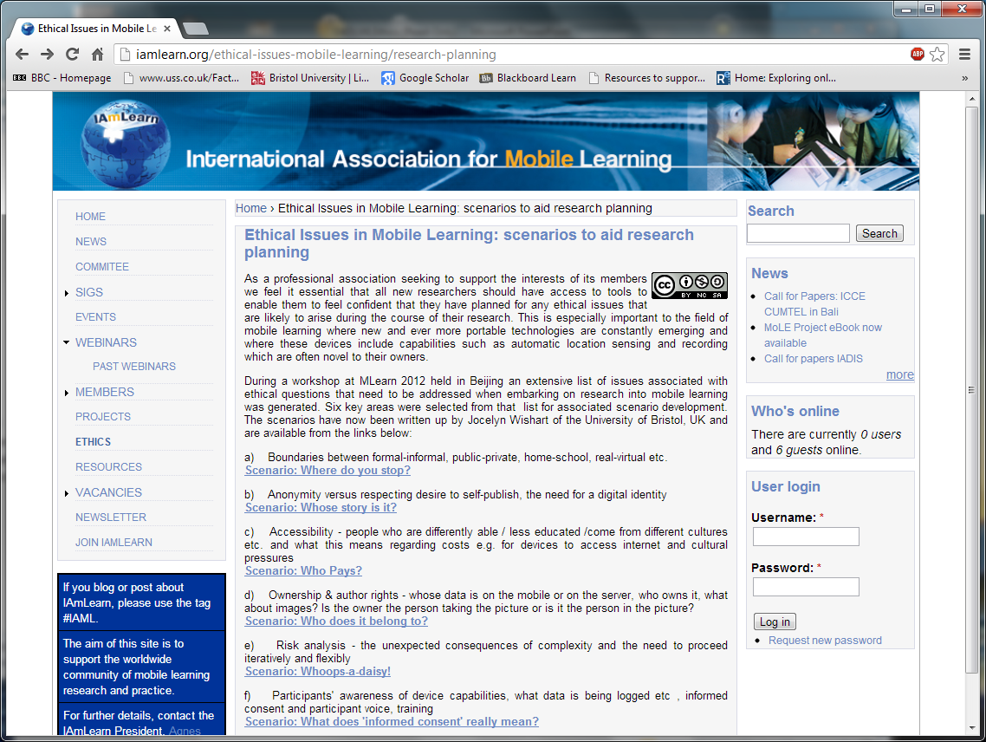

Slide 13
Now it is your turn.
 | Do good | Avoid harm | Autonomy | Justice / Equal access
Boundaries
Anonymity
Accessibility
Ownership
Awareness
Risk analysis
Think of a learning situation involving new technologies and use the above framework to develop a possible scenario. What are the ethical challenges?

Slide 14
For more detail see
Andrews, T., Dyson, L. E., & Wishart, J. (2015). Advancing ethics frameworks and scenario-based learning to support educational research into mobile learning. International Journal of Research & Method in Education,38(3), 320-334.

